Slide 1
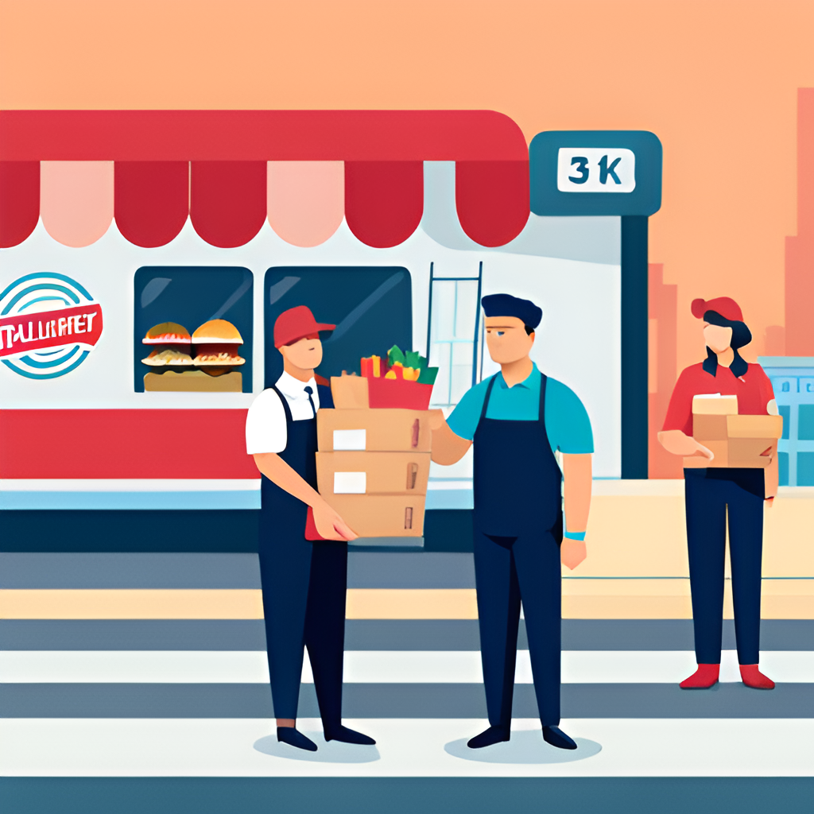
FoodFly
…
An Online Food Delivery Platform
Presented By:
Sachin Deb (1805020)
Nafis Karim (1805027)
Mamun Munshi (1805028)

Slide 2
Motivation
Easy-to-use Platform
Inclusion of Non-existent Features
More Flexibility

Slide 3
Types of User
Delivery Person
03
Customer
01
02
Restaurant Authority

Slide 4
Features | Customer

Slide 5
Features | Customer
Searching Restaurants (By location and name)
Searching Food Items
Filter Restaurants on various criterias
Get useful suggestions based on their previous order history
Order from multiple restaurants at a time
Earn some reward points on successful order
Can get discount from at most 3 assigned “Favourite Restaurants”
Reviews and Feedback
Flexible payment options

Slide 6
Features | Restaurant

Slide 7
Features | Restaurant
Add new food items
Manage existing food items
Can collaborate with another restaurant
Advertise their food items
Provide discount offers

Slide 8
Features | Delivery Person

Slide 9
Features | Delivery Person
Can choose the most feasible orders from existing orders
Can deliver orders from multiple restaurants at the same time
May decline a delivery offer
Can update the delivery status (e.g. picked up, delivered)

Slide 10
Payment Options
Mobile Banking
03
Cash On Delivery
01
02
Card

Slide 11
Thank You

